Slide 1


FailNet: Bayesian Failure Prediction & Intervention for Multi-Agent LLMs
Team Rocks
CH.SC.U4AIE24041 – Lakshmi Kanthan S
CH.SC.U4AIE24077 – V S Naren Kumar
CH.SC.U4AIE24055 – Prajesh K
Notes:
7.2013
7.2013
1
‹#›
‹#›

Slide 2
Problem Statement
Multi-agent LLM systems execute complex, autonomous workflows where failures are highly unpredictable.
Agent trajectories contain cascading errors, where a single flawed plan can trigger downstream hallucinations.
Current observability tools act as reactive black boxes, only logging errors after a catastrophic crash occurs.
This prevents actionable root-cause diagnosis, as standard machine learning classifiers cannot explain why a system failed.
Unmonitored agents can silently enter infinite loops, leading to wasted API costs and corrupted system states.
Hence, an interpretable Bayesian Network is needed to proactively predict risk, diagnose root causes, and recommend interventions.
Notes:
7.2013
7.2013
1
‹#›
‹#›

Slide 3
Why Did We Choose This Problem?
Multi-agent frameworks are rapidly replacing single LLMs, becoming the new standard for complex automation.
However, these autonomous systems lack robust safety nets and are highly prone to cascading, expensive failures.
Existing observability tools only provide post-crash logs, which are insufficient for systems acting in real-time.
There is a critical research gap in applying interpretable, causal models to AI agent monitoring.
Solving this problem is essential for safely deploying autonomous multi-agent workflows in high-stakes environments.
Notes:
7.2013
7.2013
1
‹#›
‹#›

Slide 4
What We Are Going to Do / Course of Action
Define a 24-node Directed Acyclic Graph (DAG) that models the causal dependencies of multi-agent failures.
Ingest agent trajectory data and categorize node features into observable, heuristic, and proxy-labeled tiers.
Apply Bayesian parameter learning with Dirichlet smoothing to robustly estimate conditional probabilities.
Implement exact inference (Variable Elimination) for real-time risk prediction and MAP root-cause diagnosis.
Formulate a decision-theoretic policy to map predicted failure risks to optimal system interventions (e.g., Halt, Retry).
Evaluate the Bayesian Network against discriminative baselines and demonstrate the system via a live monitoring dashboard.
Notes:
7.2013
7.2013
1
‹#›
‹#›

Slide 5
Expected outcome
A fully functional, mathematically sound Bayesian Network capable of real-time failure prediction for multi-agent systems.
The ability to perform causal MAP diagnosis, explaining exactly why an agent failed, rather than just returning a raw risk score.
A robust decision policy layer that successfully translates risk probabilities into automated, cost-saving system interventions.
Empirical proof that generative Bayesian models offer superior interpretability and resilience to missing data compared to standard ML classifiers.
An interactive monitoring dashboard that bridges the gap between theoretical probabilistic reasoning and practical AI observability.
Notes:
7.2013
7.2013
1
‹#›
‹#›

Slide 6
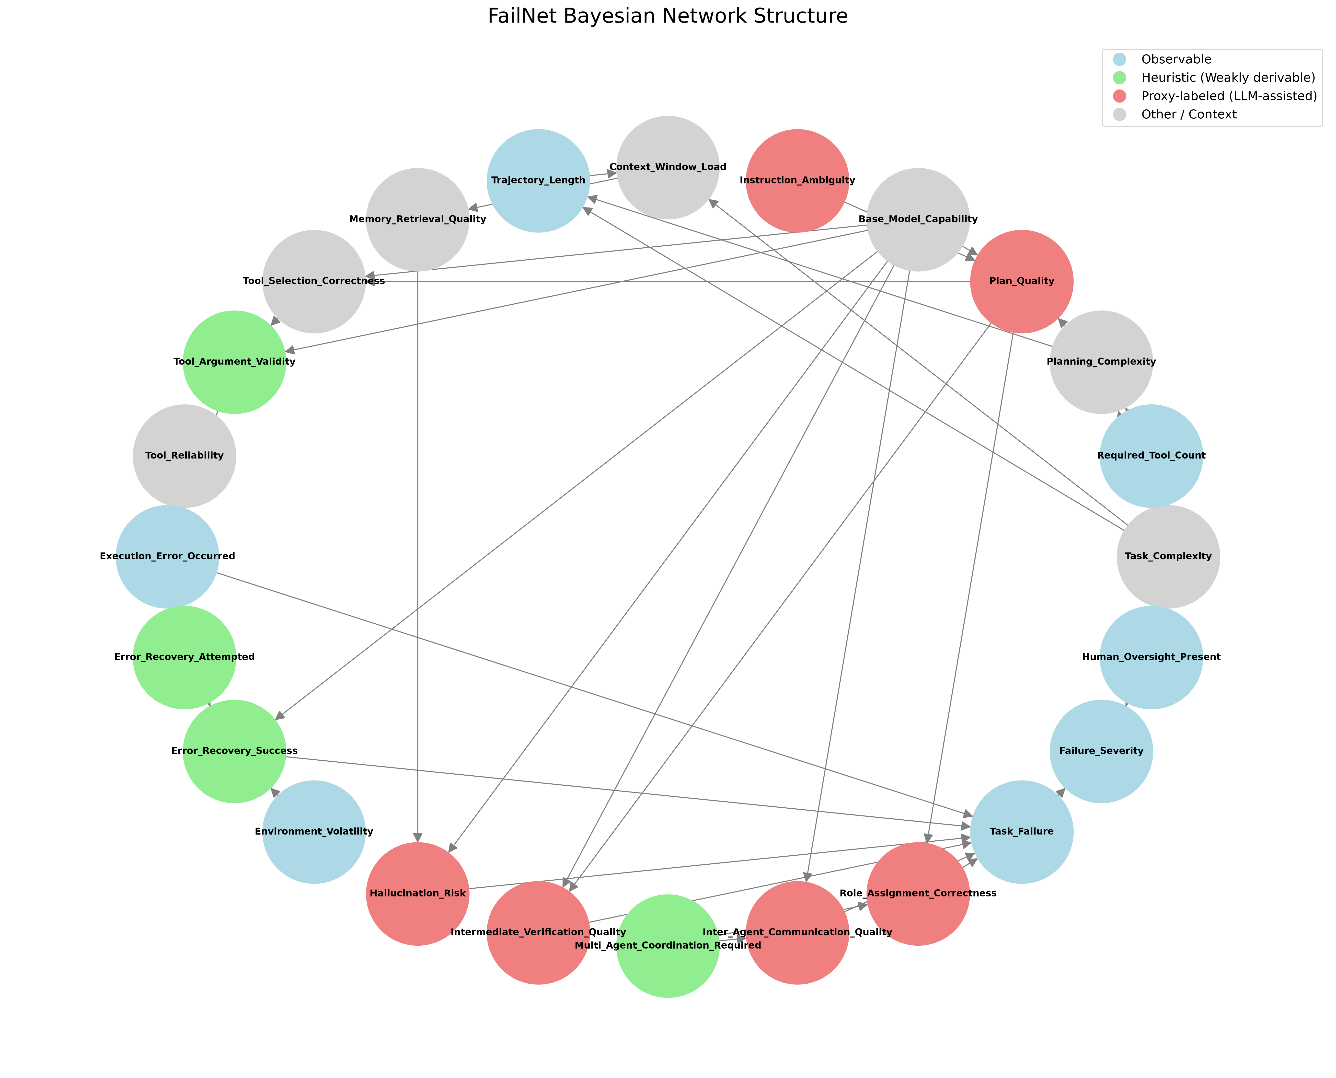

Slide 7
Literature Survey
ProbGuard: Probabilistic runtime monitoring for LLM agent safety
  Introduces a framework designed to monitor Large Language Model (LLM) agents during execution to detect and prevent unsafe or undesirable actions.
  It employs probabilistic methods to assess risks in real-time, acting as a dynamic safeguard while the agent interacts with its environment.
Which Agent Causes Task Failures and When? On Automated Failure Attribution of LLM Multi-Agent Systems
  Addresses the debugging challenge in complex environments by investigating how to pinpoint errors when multiple LLM agents collaborate on a single task.
  Proposes an automated approach to trace task failures back to the specific offending agent and the exact temporal step where the error originated.
Why Do Multi-Agent LLM Systems Fail?
  Provides a comprehensive analysis and taxonomy of the common vulnerabilities, bottlenecks, and failure modes specific to multi-agent LLM architectures.
  Investigates systemic issues—such as inter-agent miscommunication, loop behaviors, and cascading hallucinations—to guide the development of more robust collaborative AI systems.
Notes:
7.2013
7.2013
1
‹#›
‹#›

Slide 8
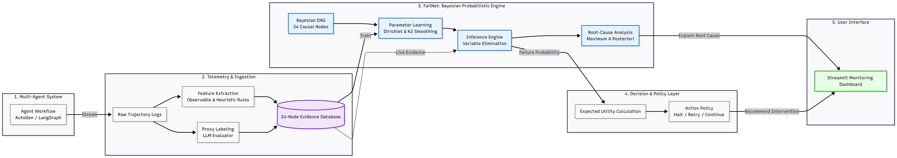
Architecture Diagram
Notes:
7.2013
7.2013
1
‹#›
‹#›

